Slide 1
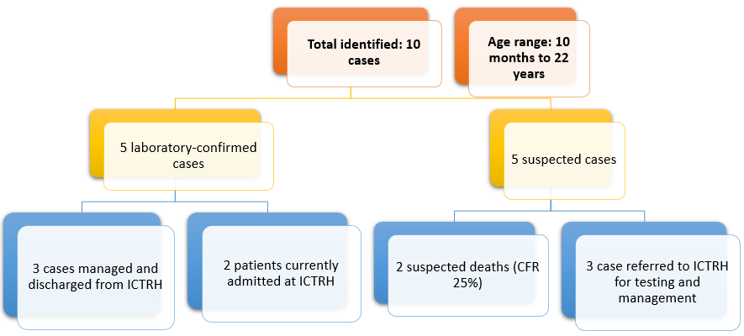
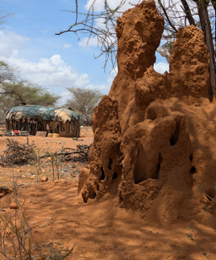
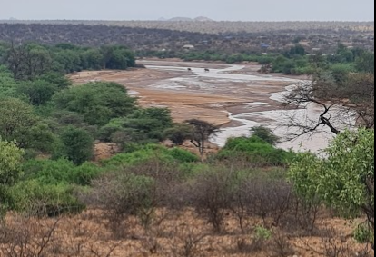
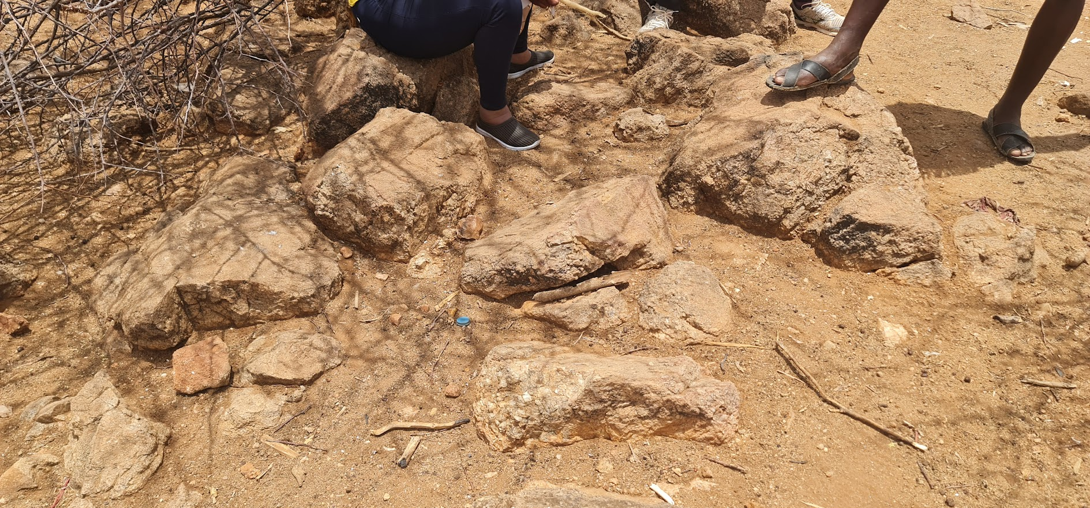
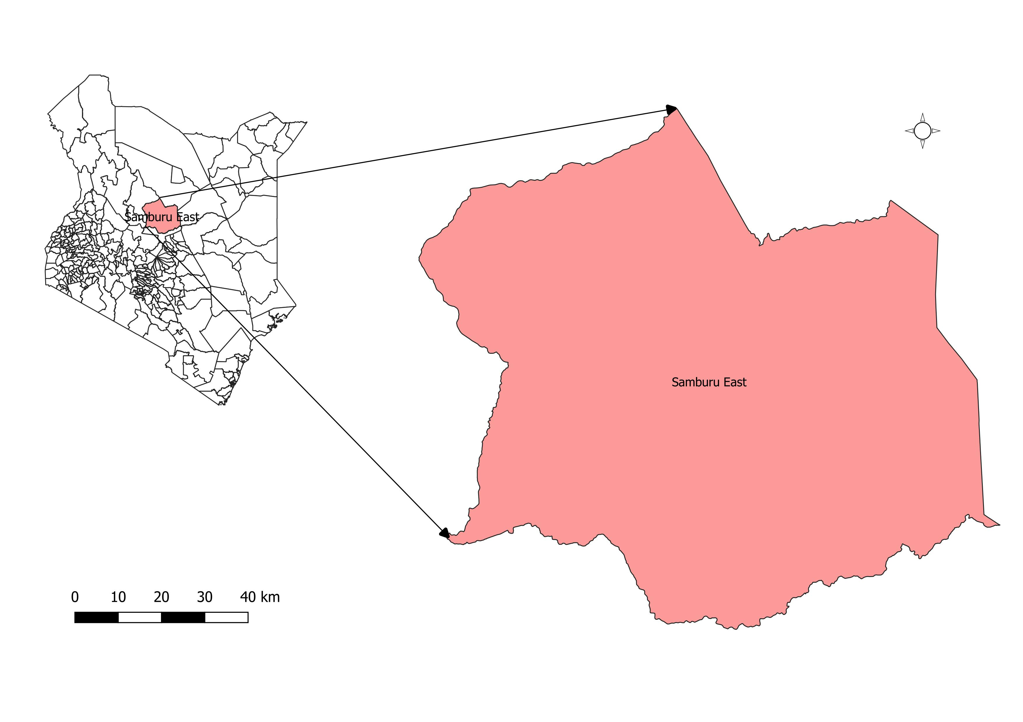
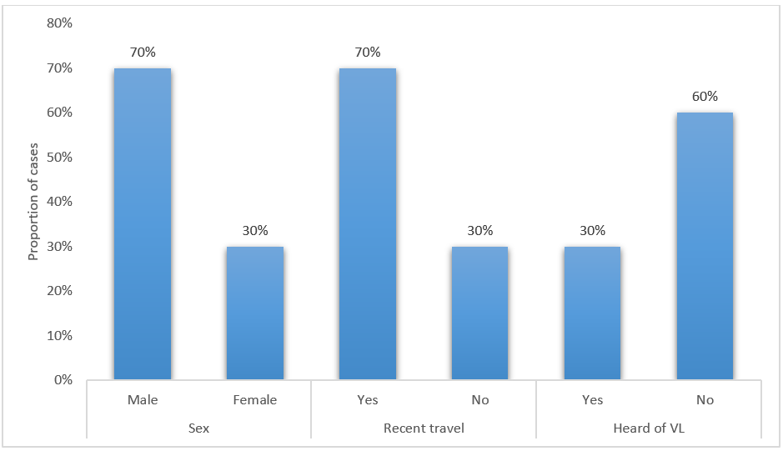
Outbreak Investigation: Visceral Leishmaniasis in Samburu County, March 2025
Francis Muoka^{1,&}, Elias Lentilai¹, Jemimah Mwangi², Laban Kungu¹, Paul Kibati³, Augustine Lkeitan¹
¹Samburu County Department of Medical Services, Public Health & Sanitation, Maralal, Kenya, ²Field Epidemiology and Laboratory Training Program, Nairobi, Kenya, ³AMREF Health Africa, Nairobi, Kenya
BACKGROUND
RESULTS
DISCUSSION
Leishmaniasis is a neglected tropical disease (NTD) caused by intracellular parasites of the Leishmania genus
Transmission through the bite of infected female phlebotomine sandflies (Phlebotomus and Lutzomyia species
Significant morbidity and mortality, particularly in Asia, Africa, and South America
Manifests in three main forms; visceral leishmaniasis (VL), cutaneous leishmaniasis (CL), and mucocutaneous leishmaniasis (MCL), with post-kala-azar dermal leishmaniasis (PKDL) occurring as a VL complication
Kenya is among the five East African countries with a high VL burden reporting about 1,600 cases annually
Visceral Leishmaniasis (VL), or Kala Azar, endemic within 11 counties in Kenya
Samburu County reported suspected cases of VL in Samburu East Subcounty in March 2025
Detection and Notification
Outbreak detection by the attending nurse at Westgate Dispensary
Index case presented on January 15, 2025
The county notified the Ministry of Health on March 7, 2025
Patients managed empirically for more than two weeks before VL was suspected
Cumulatively, 10 cases detected during the outbreak
Three (3) samples collected from suspected cases tested positive for VL at Isiolo CRH
Two (2) deaths attributed to VL within Wamba West Ward between January and March 2025
Delayed detection of the outbreak was due to an inadequate capacity to detect the cases
Geographical proximity of the outbreak to Isiolo county - subcounty lies between Isiolo and Marsabit counties, VL endemic in both counties
Delayed notification of the outbreak to the national level resulting in response delay
Cases predominantly affecting young individuals
Community spends evening hours outdoors with no protection increasing risk of vector exposure
Presence of anthills, mud houses and riverine vegetation – breeding site for sandflies
Symptoms consistent with VL commonly attributed to witchcraft by the community
Feedback from community leaders indicates existence of VL cases within the area for more than decade before the index case
Epidemiology of cases
Figure 2: Epidemiological analysis of VL cases in Wamba West Ward, January – March 2025
OBJECTIVES
Total cases detected – 10 (attack rate of 128.5/100,000)
Eight cases from Westgate area, two (2) suspected cases detected at Archers’ Post SCH
Cumulatively, 2 deaths (case fatality rate of 25%) – one (1) community (Archers’ Post) and one (1) hospital (Kiirua Hospital, Meru)
Community leaders reported similar symptoms dating back more than 10 years
To confirm aetiology of the outbreak
To estimate the magnitude of the outbreak
To determine the risk factors contributing transmission in the community
To evaluate preparedness and outbreak response capacity of Samburu County
To recommend prevention and control measures
CONCLUSION
Findings suggest that VL is endemic in parts of Samburu County
Samburu County lacks adequate capacity for detection, confirmation and management of VL cases
Inadequate capacity (healthcare workers and laboratory) possibly led to late detection of the cases
Low risk perception about VL is a possible factor for disease transmission in the community
Geographical/manmade features of the affected area likely provide breeding sites for the vector
METHODOLOGY
Clinical Presentation
Persistent fever >1months
Abdominal distension-Hepatosplenomegally
Significant weight loss
Anemia/pallor
Others: jaundice, vomiting, oral ulcerations
VL case definition: any person presenting with fever lasting more than two weeks, and either splenomegaly, weight loss, or lymphadenopathy
Investigation period from 9th – 15th March 2025
Investigation site – Wamba West Ward, Samburu East, Samburu County
Multidisciplinary team – KNPHI, County and Amref Health Africa
Desk review of surveillance data in IDSR for the trend of VL and other relevant conditions in Samburu County.
Review of hospital records for patients with suspected VL and prolonged febrile illness from December – March 2025.
Active case finding within communities
Collecting samples from suspected cases
We conducting verbal autopsies
Sensitization of healthcare workers
RECOMMENDATIONS
Risk Factors
Comprehensive active case search within Wamba West Ward and surrounding wards
Capacity building for healthcare workers on VL case detection and management.
Strengthening surveillance systems for early case detection and reporting
Community awareness campaigns on VL prevention and early symptom recognition in Samburu East Sub-county
Establishment of a VL diagnostic and treatment centre in Samburu East Sub-county to ensure access for the community
Strengthen inter-county referral mechanisms between Samburu and Isiolo counties to improve timely access to diagnosis and treatment
Vector survey and analysis
STUDY AREA
PUBLIC HEALTH ACTIONS
Samburu East Subcounty, Kenya
Sensitization of Community Health Promoters on VL
Capacity building of HCWs on VL detection, testing and management
Identification of Archers’ Post SCH as a VL treatment centre
Vector survey
Figure 3: Possible vector breeding site in the Westgate Area, Wamba West ward
LIMITATIONS
Vast distances presented logistical challenges
Poor recording keeping at the facility level
Inadequate resources (time and financial) for a comprehensive investigation
Long turnaround time of vector analysis results from KEMRI
Figure 4: A map of Samburu East Subcounty
Figure 4: Distribution of VL cases by gender, travel to endemic areas and knowledge of VL
Contact: nyaikafrank@gmail.com

